Slide 1
Chapter 8
Cultures
Notes:
As we move forward to discuss the influence of social factors on human behavior, the remaining chapters in Hutchinson explain how these various systems which have social components and configurations at the base of their function shape our perception and understanding of how/why we behave the way we do in accordance with the every changing social environment.

Slide 2
The Challenge of Defining Culture
Defining culture is complex and arbitrary
  Tend to reflect theoretical perspectives and purposes of the definers
Culture is both shared and contested
Hutchison, Dimensions of Human Behavior, 6e
SAGE Publishing, 2019

Slide 3
A Preliminary Definition of Culture
“A set of common understandings, manifest in act and artifact”
  Inside somebody’s head as understandings
  In the external environment as act and artifact
Includes both behavior (act or actions) and the material outcomes of that behavior
Involves the construction of meanings associated with the social and material world
No agreed-upon definition
Hutchison, Dimensions of Human Behavior, 6e
SAGE Publishing, 2019

Slide 4
Theories of Culture
Studying culture
  Humanities approach: Fine arts
  Social science approach
    Society’s complete way of life
Human agency: ability of people to act independently and make their own changes
Hutchison, Dimensions of Human Behavior, 6e
SAGE Publishing, 2019
Notes:
In the humanities approach, in terms of a common usage, culture is associated with the fine and performing arts. Traditionally societies and groups were evaluated on the basis of their art and literature products. In the social science approach culture refers to a society’s total way of life.
There are two competing assumptions that exist about behavior—they are centered around whether human behavior is determined by forces beyond the control of the person or whether people are free, proactive agents in the creation of their behavior. That controversy shows up in theories of culture, and it ultimately amounts to the ides of human agency

Slide 5
Theories of Culture
Materialist perspective: emphasis on environment, technology, and economy’s role creating, maintaining, and changing culture
  Marxism
  Neo-Marxist critical theory
  Cultural ecology
Hutchison, Dimensions of Human Behavior, 6e
SAGE Publishing, 2019
Notes:
The materialist perspective places emphasis on the role of the environment, technology, and economy in creating, changing and maintaining culture. Ideas, values and cultural products are seen as adaptations to environmental, technological and economic conditions.
The most well know materialist perspective is Marxism. It focuses on the economic institution, it proposes that culture is driven by the economic organization of a society. It suggests that what we are aware of, how we think and feel are cultural byproducts of the economic system. Neo Marxist critical theory, focuses on the culture industry that mass produces popular culture products such as movies, TV, and social media, arguing that products of this industry manipulate humans into passivity. While, marxism focuses on the economic industry and neo-Marxist critical theory focuses on the culture industry, cultural ecology focuses on the impact of the physical environment on culture. Cultural ecologists are also interested in how humans adapt their cultures to the natural environment and how humans modify nature to suit their needs.

Slide 6
Theories of Culture
Mentalist perspective: create, maintain, and change culture based on their beliefs, values, language, and symbolic representations
  Interpretive anthropology
  Culturalism
  Structuralism
  Poststructuralism
  Postmodernism
Hutchison, Dimensions of Human Behavior, 6e
SAGE Publishing, 2019
Notes:
The mentalist perspective sees humans creating, maintaining, and changing culture on the basis of their (SLIDE POINT).
Culturalism emphasizes the creative way that people participate in shared meaning. In this view culture unfolds overtime as people interact. In this views there is much room human agency.
Structuralism examines culture as a byproduct of the brains mental structure. Specifically it proposes that the structure of human cognition leads us to conceptualize the world in terms of binary opposites. So in this case these is little room for human agency.
Poststructuralism on the other hand rejects the idea of an underlying stable structure of culture, especially the idea of making meaning through fixed binary. For example it is in agreement with gender as a non-binary attribute.
Postmodernism argues that truth and meaning are perspectival

Slide 7
Theories of Culture
3 major culture types
  Traditional culture (premodern culture): pre-industrial societies based on subsistence agriculture
  Modern culture: characterized by rationality, industrialization, urbanization, and capitalism of the 20th century
  Postmodernism: contemporary culture characterized by global electronic communications
Hutchison, Dimensions of Human Behavior, 6e
SAGE Publishing, 2019

Slide 8
Other Theoretical Perspectives
Practice orientation: wants to explain what people do; how do social systems shape, values, beliefs, and behavior; how do people perpetuate or change culture
  Key elements
    History
    Social structure
    Human agency
Hutchison, Dimensions of Human Behavior, 6e
SAGE Publishing, 2019

Slide 9
A Practice Orientation
A postmodern theoretical orientation that
  Focuses on people’s actions as expressions of their worldview and their ethos
  Seeks to explain cultural innovation by what people do as thinking, intentionally acting persons in the face of embedded ideologies and cultural conflict
  Explores different meanings for things we take for granted and variation in the social environment
Hutchison, Dimensions of Human Behavior, 6e
SAGE Publishing, 2019

Slide 10
History
History: includes chains of events and experiences to which people react
  Consider people’s diverse motives and actions as they make and transform the world in which they live, the memories of official and unofficial observers
Hutchison, Dimensions of Human Behavior, 6e
SAGE Publishing, 2019

Slide 11
Structure
Structure: ordered forms and systems of human behavior in public life
  Consider how we reproduce trends, patterns, and structures when we assume the rightness of our values, beliefs, and meaning and see no need to change them; how hegemony (dominance of a particular way of seeing the world) is a barrier to cultural change
Hutchison, Dimensions of Human Behavior, 6e
SAGE Publishing, 2019

Slide 12
Human Agency
Consider that people construct culture by investing the world with subjective order, meaning, and value; that they can construct social and political identities to resist and contest cultural hegemony
No individual is fully a free agent
Constrained by external factors, such as climate, disease, natural resources, population size and growth
Hutchison, Dimensions of Human Behavior, 6e
SAGE Publishing, 2019

Slide 13
Major Concepts in Culture
Values
  Beliefs about what is important or unimportant, desirable or undesirable, and right or wrong
  Not shared by all
  May be at odds with each other
    Balance is necessary
  Differs based on location
    Individualistic
    Collectivistic
Hutchison, Dimensions of Human Behavior, 6e
SAGE Publishing, 2019

Slide 14
Major Concepts in Culture
Ideology
  Set of shared beliefs that explain the social world and guide people’s actions, especially in relation to economic and political theory and policy
Symbols
  Something that stands for something else
  Types: verbal, nonverbal, artifact
Hutchison, Dimensions of Human Behavior, 6e
SAGE Publishing, 2019

Slide 15
Major Concepts in Culture
Language
  System of words or signs used to express thoughts and feelings
  Types: spoken, written, nonverbal
Norms
  Culturally defined standards of conduct
  Folkways: desirable behavior, not strictly enforced
  Mores: hold moral significance, more important
Hutchison, Dimensions of Human Behavior, 6e
SAGE Publishing, 2019

Slide 16
Major Concepts in Culture
Subculture
  Involve people who accept much of the dominant culture but distinguish themselves by one or more culturally significant characteristics
  i.e., social work club
Counterculture
  Differs in significant ways from dominant culture, also rejects norms and values of the larger culture
  i.e., Amish, Ku Klux Klan
Hutchison, Dimensions of Human Behavior, 6e
SAGE Publishing, 2019

Slide 17
Major Concepts in Culture
Ideal culture vs. real culture
  Ideal: values and practices that are considered desirable
  Real: what people actually think and do
  May not be realized; ignored
  i.e., supporting democracy but not voting, saying all lives matter but overlooking high death rates for others; supporting the American dream but not giving others a chance
Hutchison, Dimensions of Human Behavior, 6e
SAGE Publishing, 2019

Slide 18
Quick Write Activity
Which cultures are you a part of?
  Name at least two values and two norms for each
Example cultures, subcultures, countercultures:
  UTA
  Graduate student
  Social work
  Cohort
  Social media
  Family/Social Networks you belong to
  Deaf community
  National residency
  Ancestral heritage based
Notes:
Are there any conflicts in values and norms across the different cultures in which you participate?
Values are: Beliefs about what is important or unimportant, desirable or undesirable, and right or wrong
Not shared by all
May be at odds with each other
Norms are: Culturally defined standards of conduct
Folkways: desirable behavior, not strictly enforced
Mores: hold moral significance, more important

Slide 19
Ethnocentrism and Cultural Relativism
Ethnocentrism: belief that one’s own culture is normal, natural, and superior to other cultures
  Can be a barrier, creates misunderstandings
Cultural relativism: calls to suspend judgment of other cultural values and practices in order to understand them in their own cultural context
  Don’t need to accept or agree with cultural practices—it’s about understanding them
Cultural humility: individual’s culture has pros and cons too; other cultures shouldn’t be judged
Hutchison, Dimensions of Human Behavior, 6e
SAGE Publishing, 2019
Notes:
Culture is learned overtime from people that we care about and many people think that their culture is the best.
Other cultures are judged by the standards of one’s own culture
Most societies instill some degree of ethnocentrism in their members as a way to hold the culture together. But it can create a barrier to cross-cultural understanding. It can encourage hostility, war, and racism.
Social scientists have suggested cultural relativism to combat our tendencies toward ethnocentrism. It is a very important approach for social worker to incorporate in practice at every level.
However this requires us to approach social work practice with cultural humility which involves recognizing that culture is an important part of human behavior, that people live within many different cultures and that we will never understand other cultures as well as the people who live within them.

Slide 20
Ethnocentrism and Cultural Relativism
Prejudice: negative thoughts, attitudes, or emotions about members of a social group
Stereotypes: general characteristics to describe a group of people
Implicit bias: unconscious positive or negative attitudes for one group over another
Xenophobia: fear/hatred of foreigners or foreign things
Hutchison, Dimensions of Human Behavior, 6e
SAGE Publishing, 2019
Notes:
Both prejudice and stereotyping are complex cognitive processes.
Research indicates that the amygdala is the part of the brain that is responsible for our rapid appraisals. The amygdala is so fast that it responds in advance of our awareness. And prejudice is many times an unconscious process known as implicit bias. Implicit bias is very difficult to change especially within cultures that reinforce the bias.
The best known intervention for implicit bias involves raising peoples awareness of the human tendency for implicit bias

Slide 21
Culture and Power
Power: ability to act in a chosen way and to direct or influence the behavior of others
  Can create an imbalance between groups when power is not equal
Hegemony: ability of a dominant group to obtain consent and agreement to cultural values and norms without use or threat of force
Hutchison, Dimensions of Human Behavior, 6e
SAGE Publishing, 2019
Notes:
Dynamics of power are often embedded within culture. Power can be thought of as the (READ SLIDE)
Culturally instilled knowledge and attitudes lead people to accept some power arrangements and reject others. Cultural understanding of who should be powerful and who should be powerless have deep historical roots, yet history itself is often told from the perspective of people who have the power to construct it.
With this hegemony of values and norms, some thoughts become unthinkable. People discipline their behavior to be in accord of what is considered normal (EVEN when it runs counter to their own personal interests)
In the next few slides we will take a look at how various social identities are embedded in cultural dynamics of power. Race, ethnicity, gender, sexuality, social class and disability

Slide 22
Culture and Power
Race: system of classification using certain physical characteristics to divide people into supposedly discrete groups
  System is flawed
  No genetically distinct groups of people
  Racialization can lead to unrelated groups of people being grouped together.
  Can lead to supremacy groups (racial ideology)
  Hypodescent: kids of mixed-race unions ascribed to subordinate group
Hutchison, Dimensions of Human Behavior, 6e
SAGE Publishing, 2019
Notes:
There are more genetic differences within groups than between various racial groups

Slide 23
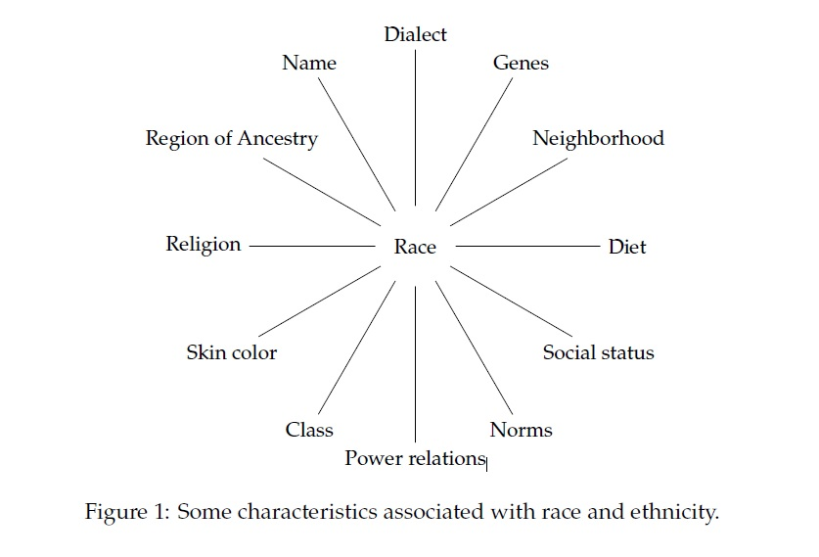
Race as a bundle of sticks
Notes:
Obtained from: Sen, M., & Wasow, O. (2016). Race as a bundle of sticks: Designs that estimate effects of seemingly immutable characteristics. Annual Review of Political Science, 19.

Slide 24
Culture and Power
Race
  Inequality still persists; creates wide disparities
  Racism: belief that race accounts for differences in character or ability; one race is superior to others; justifies imbalanced opportunities
  Individual racism
  Institutional racism
Hutchison, Dimensions of Human Behavior, 6e
SAGE Publishing, 2019
Notes:
Color Blind Racism:
Pretending not to notice race as a “strategy” to end racism
Aversive Racism:
Allows people to maintain a positive self-image while perpetuating racism: (e.g., avoiding openly racial references with coded terms such as …
“diverse” “urban” “underprivileged”
Internalized Racial Oppression
Unconscious internalization of beliefs of racial inferiority by people of color in a white supremacist society

Slide 25
Culture and Power
Ethnicity: sense of cultural, historical, and ancestral connection to a group of people
  Ethnic identity: part of identity derived from one’s sense of being part of an ethnic group
  Assimilation: minority groups/immigrants expected to adopt new culture’s norms
  Multiculturalism: minority groups/immigrants retain original ethnic culture and pick up new culture
  Ethnic cleansing: ridding area of minorities
Hutchison, Dimensions of Human Behavior, 6e
SAGE Publishing, 2019

Slide 26
Culture and Power
Gender: composed of expectations about behaviors, attitudes, and personalities that cultures assign to people of different sexes
  Culturally created
  Sex is biologically determined
  Intersex: individuals with bodies not clearly female or male
  Male and female stereotypes contribute to gender
Hutchison, Dimensions of Human Behavior, 6e
SAGE Publishing, 2019
Notes:
Western understanding of gender has been based on the assumption that gender flows automatically from genitalia and reproductive organs and that strong, clear gender differences exist, based on sex. However, Sex is biologically determined, but gender is socially constructed and learned through culture.
There is nothing biological about which clothes people should wear,
Guest suggests that gender is “taught, learned, performed, and policed”
Cultural ideology can be so strong threat gender expectations can be seen as natural and normal
Gender must be examined, however as it intersects with race, social class, and sexuality because different stereotypes have developed for different groups of males and females

Slide 27
Culture and Power
Gender
  Transgender: gender identity and gender expression differs from assigned sex
  Transsexual: individual who has undergone biological transition
    Transman
    Transwoman
  Two-spirit
  Misogyny: deep dislike, contempt, of women
Hutchison, Dimensions of Human Behavior, 6e
SAGE Publishing, 2019
Notes:
Hutchenson denotes that Transgender is a term used to identify people who have gender identity (internal sense of gender) and gender expression (external expression of gender) that is different from their assigned sex. For example, a trans man refers to someone who was assigned as a girl based on female characteristics at birth but who identifies as a boy or man. Similarly, a transwoman is someone who It is often used as an umbrella term to identify people who are gender non-conforming as well as people who do not identify with either of the two culturally dominant genders
Many native north American cultures have had traditions of gender diversity, including roles for two-spirit individuals who are socially defined as neither man nor woman but a combination of the two.
Gender is not just a system of classification but it is also a system of stratification, than has most often given dominant status to men and subordinate status to women.

Slide 28
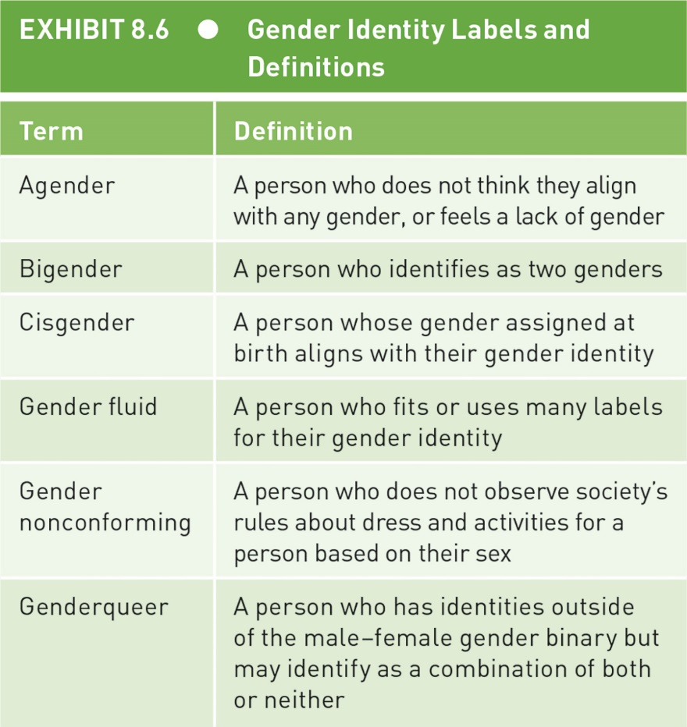
Culture and Power
Hutchison, Dimensions of Human Behavior, 6e
SAGE Publishing, 2019
Notes:
There’s no single trans path and figure 8.6 presents some of the common definitions currently used by various people to describe their gender.

Slide 29
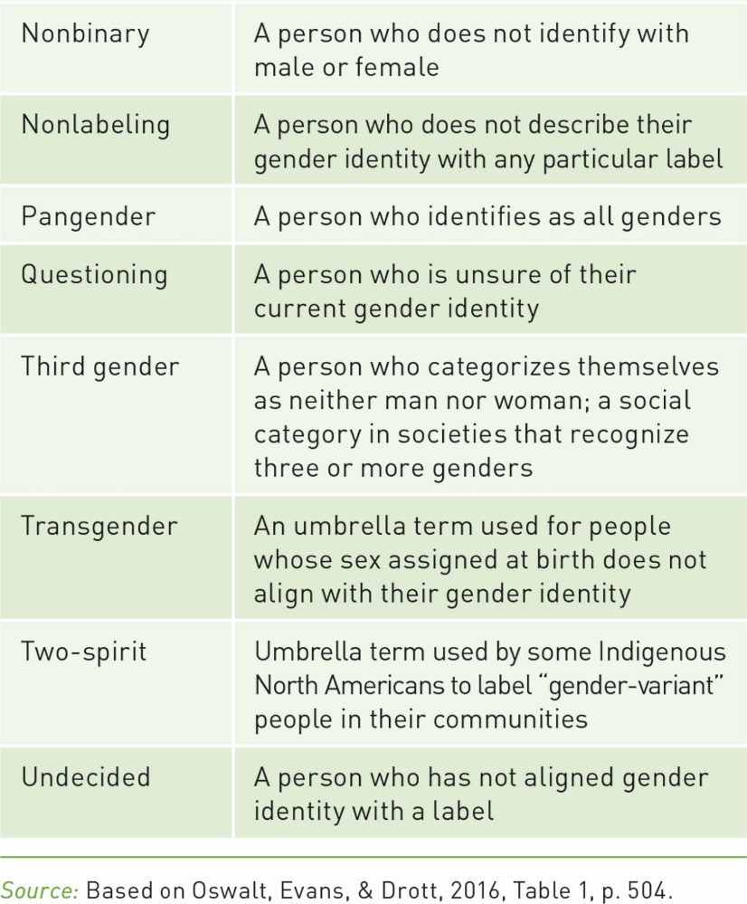
Culture and Power
Hutchison, Dimensions of Human Behavior, 6e
SAGE Publishing, 2019
Notes:
But this list should be thought of as even evolving and fluid, as people renegotiate the labels they use to describe themselves. People may or may not locate themselves in culturally established gender categories

Slide 30
Culture and Power
Sexuality
  When?
    Child brides
    Sex education in the U.S. primarily focuses on abstinence
      How helpful is this?
  Why have sex? Pleasure and/or procreation?
    Religion plays a significant role
Hutchison, Dimensions of Human Behavior, 6e
SAGE Publishing, 2019
Notes:
Sexuality is both physiological process and a cultural construction. Physiologically it involves a range of desires that are often related to erotic physical contact. Culturally, it involves debates about which kind of desires are moral, appropriate, and natural. All societies have cultural rules that attempt to regulate sexual relations—rules about how, why, when, and who is allowed to do what with whom. This makes it such that in western cultures there are limits to what’s deemed acceptable but at the same time, cultural norms are currently in fluxuation. This is only the beginning of the intersection of culture and power.

Slide 31
Culture and Power
Sexuality
  With whom?
  Spouse (most accepted)
  Extramarital partner
  Children (illegal in many countries)
  Interracial partner (Loving v. Virginia) 1967
  Same-sex partner (Obergefell v. Hodges) 2015
Hutchison, Dimensions of Human Behavior, 6e
SAGE Publishing, 2019
Notes:
Supreme court ruling

Slide 32
Culture and Power
Gender and Sexual Minorities
  LGBTQIA people
    Harassed, bullied
    Discriminated against
Hutchison, Dimensions of Human Behavior, 6e
SAGE Publishing, 2019
Notes:
In 2016, same gender sex was illegal in 65 countries and punished by death in 10 countries. The U.S. has some of the most advanced LGBTQ rights in the world but civil protections for this group still vary from jurisdiction to jurisdiction. Fewer than half of U.S. states offer protection against discrimination based on sexual orientation and gender identity. In many states, employers may fire or refuse to hire a person based on sexual orientation or gender identity and there are NO protections in regard to discrimination in public accommodations or housing.

Slide 33
Culture and Power
  Sexual assault
    U.S.: Someone is sexually assaulted every 98 seconds
    Rape culture: cultural norms that allow rape and sexual assault to be excused and legitimized, seen as inevitable
    Sex trafficking: sexually exploiting someone
Hutchison, Dimensions of Human Behavior, 6e
SAGE Publishing, 2019
Notes:
In the U.S. members of the LGBTQ community, persons with mental and physical disabilities, indigiounous people and migrants, women and children are the most vulnerable to sex trafficking.

Slide 34
Culture and Power
Social class: based on wealth, income, and social position which produces unequal access to resources
  Egalitarian societies and ranked societies.
  Culture of poverty: poverty creates beliefs, values, and behaviors (adaptations to the environment) that reinforce poverty despite economic improvements.
  Redlining: denying loans to minorities in certain areas for racist reasons
  What about studying the 1%?
Hutchison, Dimensions of Human Behavior, 6e
SAGE Publishing, 2019
Notes:
Social class is a system of power based on wealth……(READ SLIDE)
Sam discussed during our last session, how inequality is created and maintained in major societal institutions. However we should be aware that egalitarian societies have existed as well. Anthropologists suggest that until the development of agriculture about 10k years ago, human economic and social structure was organized around hunting and gathering, aka foraging. There are still some societies that are hunters and gatherers and those societies are considered egalitarian for their main practices revolve around sharing resources to ensure the success of the group. In these societies they can be quite mobile, so it makes little sense to luxuries, excess or surplus.
Other societies known as ranked societies and in this context, society is stratified by prestige and social position but wealth is not unequal, because gaining status is based on giving away surplus. Example Kwakiutl (pacific northwest) chief holds a ceremony/feast called a potlatch and gives away all personal possessions
However in the U.S. and many other countries social class is a system of social status that is based on consumption and accumulation of surplus (accumulating as many luxuries as possible)
The study of the interection of culture and social class has most often focused on people living in poverty. This culture-of-poverty approach (159, 1966) presents poverty as a cultural phenomenon created by pathology, personal feelings, families, and communities, rather than structural economic arrangements. The model was based the study of Mexican and Puerto Rican families but the concept was soon racialized to refer primarily to African Americans.. It has been twisted to suggest that black schools and communities remain poor because of beliefs, values, and morals. However no research has supported this model. One of the major factors that get left out of this type of argument is institutional racism such as redlining. Furthermore, scholars have begun to suggest that in order to understand poverty, we must seek to understand the social, economic, and polictical culture that produces class advantage for some and class disadvantage for others. Some refer to this as “studying up”.

Slide 35
Culture and Power
Disability: what is seen as a disability is culturally influenced
  Traditional model: seen as unfortunate or damaged; solution is to isolate or segregate them
  Medical model: seen as having a medical condition; solution is to fix it medically
  Social model: environment creates the perception of impairment; solution is to fix the environment
Hutchison, Dimensions of Human Behavior, 6e
SAGE Publishing, 2019
Notes:
We might think that physical, emotional or cognitive disabilities are purely biological or psychological, but the experience of disability is strongly shaped by the cultural context. SO within the social model Fixing the environment goes beyond fixing physical spaces but also adjusting social attitudes and cultural mores

Slide 36
Culture and Power
Disability
  Treatment of those with impairments: killed, abandoned, jailed, warehoused, exploited, sterilized
  Americans with Disabilities Act (ADA) 1990
    Congress recently (2018) started attempting to rollback protections
Hutchison, Dimensions of Human Behavior, 6e
SAGE Publishing, 2019

Slide 37

Everyday Ageism…
“Really? You don’t look seventy-eight!”=That's great you don't look your age!
We are reaffirming to the recipient and ourselves that the last thing any of us wants to appear is... OLD.
Notes:
274 Billion dollars a year is spent on anti-aging industry. With the same about we could eradicate extreme poverty, give access to clean water to every person in the world, stop children from dying in pain, and still have 49 billion left over.

Slide 38
Covering
Covering is the act of downplaying a disfavored identity—even when this identity is known or apparent to others—in order to present oneself more palatably as part of the so-called American mainstream. (Sociologist Erving Goffman)
The cultural imperative to conform to dominant-group norms is the under-noticed harm of assimilation—a harm that impedes the full advancement of historically marginalized groups (Kenji Yoshino)
Notes:
"Covering: The Hidden Assault on Our Civil Rights." Yoshino offers us a work that infuses cultural insight into legal argumentation, interlaced with his own exquisitely narrated story as a gay, Asian-American man.
Yoshino begins his discussion from the vantage point of gay covering as this relates most closely to his own experience, followed by a broader examination of other forms of group identity–based covering: racial covering, sex-based covering, disability-based covering, and religious covering. All of these behaviors may seem harmless, and even beneficial in the name of American assimilation, but Yoshino maintains that (READ 2nd SLIDE Point)
He wants us to seriously consider the ways in which assimilation serves to undermine the goals of the civil-rights movement by maintaining the cultural status quo of dominant groups.

Slide 39
Genes and Culture
Nature and nurture interact with each other
Gene-culture coevolutionary theory (GCT)
  How cultural and genetic processes interact over time
  Cultural changes spread more quickly
    Can lead to increases or decreases in evolution
Hutchison, Dimensions of Human Behavior, 6e
SAGE Publishing, 2019

Slide 40
Digital Culture
History
  More ordinary people using computers
  Introduction to the internet (globally)
  Evolution of the internet, i.e., social media
  Introduction of portable/handheld devices
    Includes constant access to wireless networks
Privacy?
Used in different ways in different countries
Hutchison, Dimensions of Human Behavior, 6e
SAGE Publishing, 2019

Slide 41
Digital Culture
Greater use of and reliance on the internet
  Less communication face-to-face
Fake news
  Spread by bots and algorithms
  Creates pockets of people who are increasingly polarized and paranoid or distrustful
  i.e., Pizzagate conspiracy
Hutchison, Dimensions of Human Behavior, 6e
SAGE Publishing, 2019

Slide 42
How Culture Changes
Tries to remain stable
  Needs to adapt as time passes
Innovation: new idea, tool, or method
  Primary: creation, invention, or chance discovery
  Secondary: new application or modification of something old
Diffusion: how ideas, tools, and methods spread
Cultural loss: existing tool, idea, or method is lost
Hutchison, Dimensions of Human Behavior, 6e
SAGE Publishing, 2019

Slide 43
How Culture Changes
Assimilation: cultural uniqueness of minorities is abandoned and members try to blend into the dominant culture
Accommodation: partial or selective cultural change. Nondominant groups follow norms, rules, and standards of the dominant culture only in specific circumstances and contexts
Hutchison, Dimensions of Human Behavior, 6e
SAGE Publishing, 2019
Notes:
In multicultural societies, cultural change can be understood in terms of four processes. These terms are used to describe a minority individual or minority group responses to dominant culture and can have implications for well-being
The process

Slide 44
How Culture Changes
Acculturation: mutual sharing of culture; groups remain distinct, but certain elements of culture change through exchange
Bicultural socialization: nonmajority group or member mastering the dominant culture and their own
Hutchison, Dimensions of Human Behavior, 6e
SAGE Publishing, 2019
Notes:
Acculturation is essentially a merging of cultures as a result of prolonged contact
Depending on how large the differences are between cultures, bicultural people may see their bicultural identities as incompatible or relatively conflict-free

Slide 45
Consider…
Think about a cultural change that you have seen in your lifetime. (i.e. technical innovation, fashion, attitudes about gender or sexuality, political culture)
What were the forces behind it?
What are the advantages or disadvantages of that change for society as a whole or you personally?

